Slide 1
ALPIQ Challenge
Datathon 2025 - Segfault
Agostina Vidal Villanueva, Walid Chatt, Lorenzo Furlani, Kenji Nakano

Slide 2

TABLE OF CONTENTS
01
04
02
05
03
06
DATA PREPROCESSING
MODEL EVALUATION
FEATURE SELECTION
RESULTS ANALYSIS
MODELLING
PRESENTATION

Slide 3

01
Data Preprocessing

Slide 4
DATA IMPUTATION
DATA UNIFICATION
FEATURE ENGINEERING

Slide 5
02
Feature Selection

Slide 6
The ones that made the cut
Precipitation
Hours of the day
Season
Days of the week
Relative Humidity
Cloud Coverage
7 days rolling avg
Hourly avg every 30 days

Slide 7
03
Modelling

Slide 8
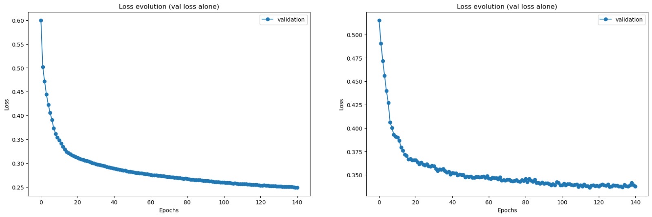
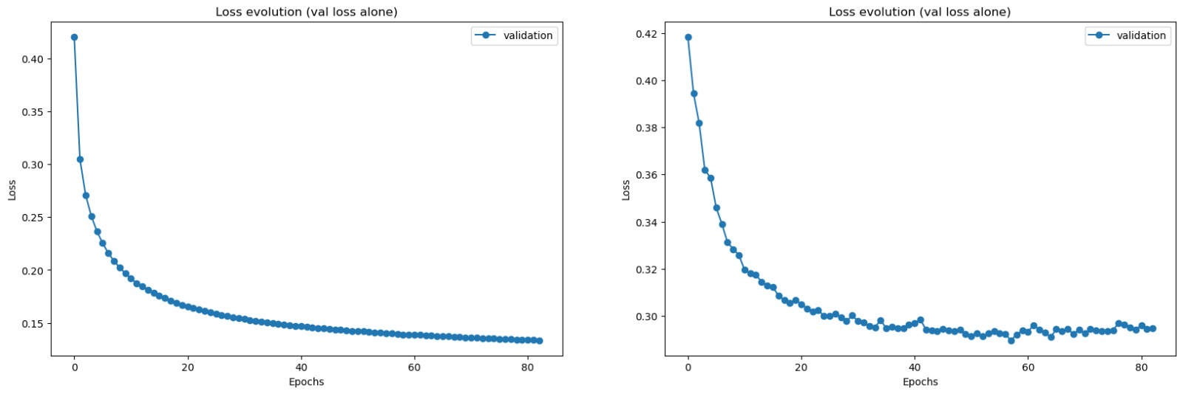
xLSTM / Transformers

Slide 9
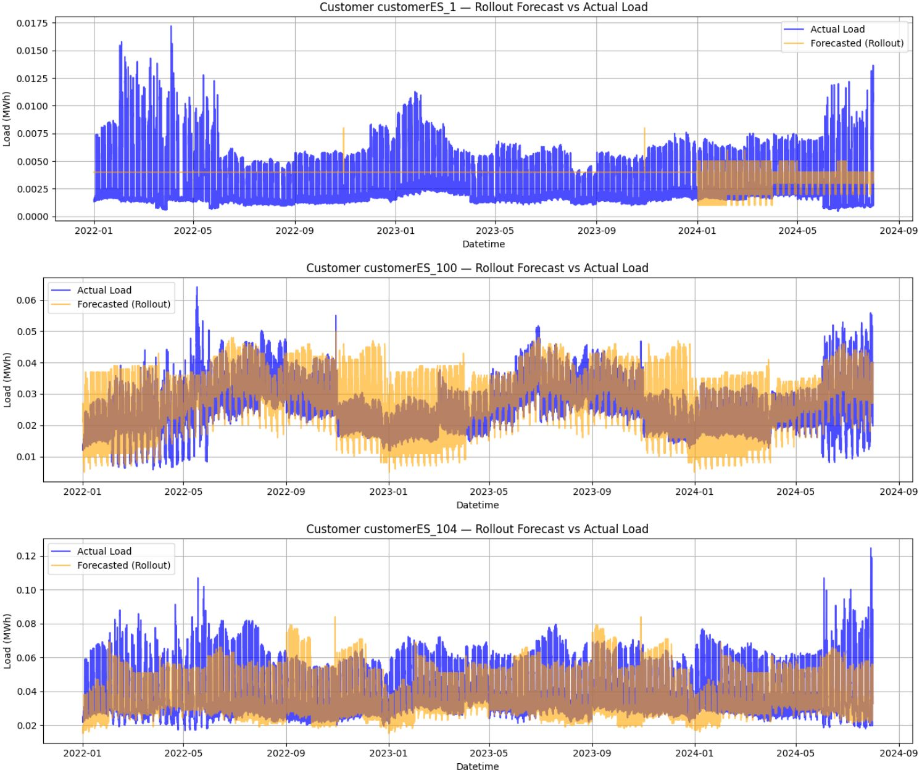
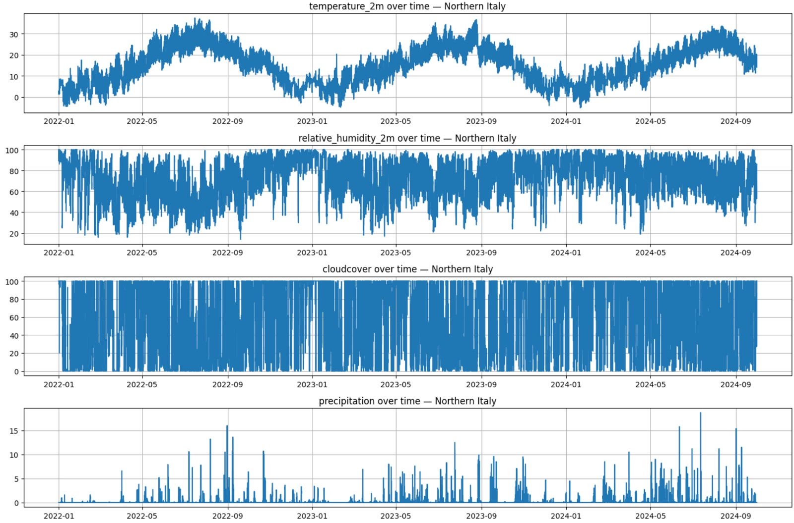
XGBoost

Slide 10
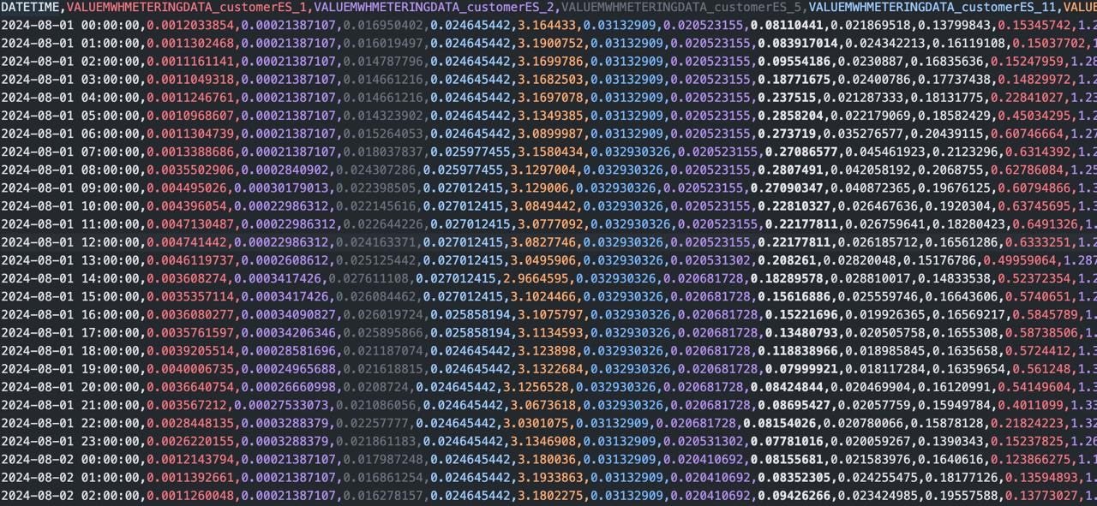
Univariate Boosting

Slide 11
04
Model Evaluation

Slide 12
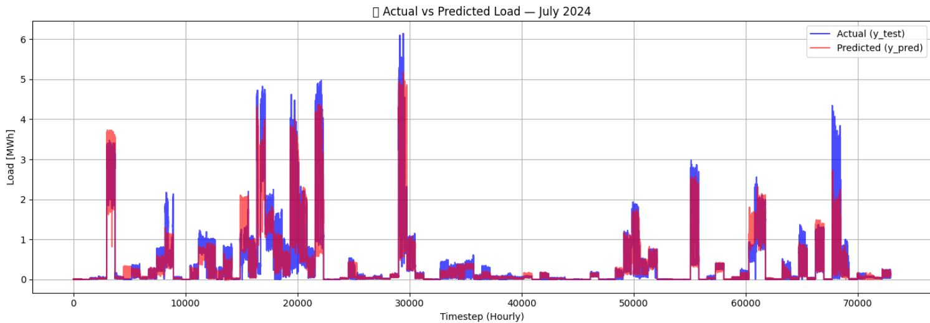

Slide 13
05
Results
Analysis

Slide 14
04
Presentation

Slide 15
THANK YOU FOR LISTENING!
Do you have any questions?
Please keep this slide for attribution

